Slide 1
Domain Name System (DNS)
June 2015

Slide 2
Agenda
I. Introduction
II.DNS in protocol
III. DNS in configuration
IV. Advanced features
V. Tools
VI. Demo
VII. ALU DNS 6.0
VIII. References

Slide 3
Introduction
Using a host name is preferred when communicating over a network. Easily remembered than an IP address
Before 1982, HOSTS.TXT is used to map names to numerical addresses and each computer retrieved this file a computer at SRI
The rapid growth of the network made a centrally maintained, hand-crafted HOSTS.TXT unsustainable
A more scalable system is needed so Domain Name System (DNS) was invented in 1983

Slide 4
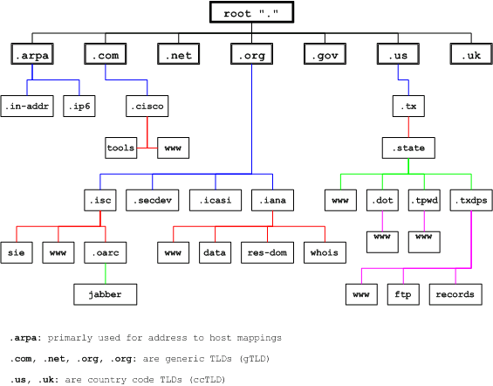
Introduction
DNS is a hierarchical distributed naming system for computers, services, or any resource connected to the Internet or a private network

